Slide 1

Stroke Data Analysis

Slide 2
Collaborators
Maira Syed
Aruna Venkatachalam
Jalees Moeen

Slide 3

Table of Contents
Introduction
Objective
Data Sources
Research Questions
Exploratory Data Analysis
Conclusion
Appendix

Slide 4
Introduction
What is Stroke?
A stroke is sometimes also called a brain attack.
Stroke is caused by interruptions to the normal flow of blood to the heart.
Consequences of a stroke.
Notes:
1. Stroke _ occurs when something blocks blood supply to part of the brain or when a blood vessel in the brain bursts.A stroke, sometimes called a brain attack, occurs when something blocks blood supply to part of the brain or when a blood vessel in the brain bursts.
2.In either case, parts of the brain become damaged or die. A stroke can cause lasting brain damage, long-term disability, or even death.
3. Stroke is a leading cause of disability and mortality worldwide, making it a critical area of study in the field of public health.
4. It is a critical health condition with severe consequences, making proactive risk assessment and targeted interventions imperative for minimizing its impact.

Slide 5
Objective
Perform a comprehensive analysis of stroke data
Gain insights into risk factors for stroke occurrences.
Address specific research questions related to stroke occurrence.
Notes:
Our analysis delves into a comprehensive examination of stroke data to better understand its risk factors and implications for healthcare.
Stroke data analysis serves as a valuable tool for identifying potential risk factors, developing preventive strategies, and enhancing patient care.
we aim to explore the dataset, uncover key insights, and address specific research questions related to stroke occurrence.
Purpose of this analysis is to contribute to understand the major factors that leads to stroke.

Slide 6

Data Sources
EDA Dataset for Stroke
https://www.kaggle.com/datasets/fedesoriano/stroke-prediction-dataset
Notes:
This dataset is used to predict whether a patient is likely to get stroke based on the input parameters like gender, age, and various diseases and smoking status

Slide 7

Research Questions
Determine the significant risk factors
Assess the relative importance of these risk factors
Classification & Data Visualization.
Assess an individual's risk of experiencing a stroke.
Examine stroke rates.
Possible identification of key factors (correlation)
Notes:
Determine the most significant risk factors associated with stroke, such as hypertension, smoking, diabetes, obesity, and more.
Assess the relative importance of these risk factors through statistical analysis like logistic regression.
Classification on the basis of gender, age group and work types.
Develop predictive models to assess an individual's risk of experiencing a stroke based on their demographic and health-related attributes.
Examine how stroke rates is affected based on marital status, bmi, residence and smoking habit.
Can we identify other key factors or combinations of factors that correlate strongly with stroke incidence.

Slide 8
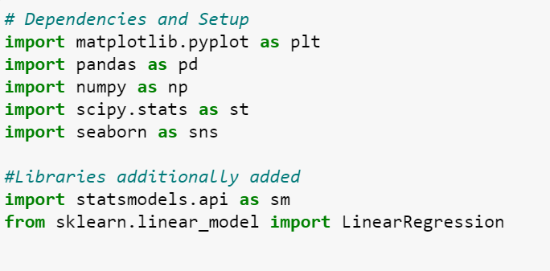
Tools & Libraries

Slide 9
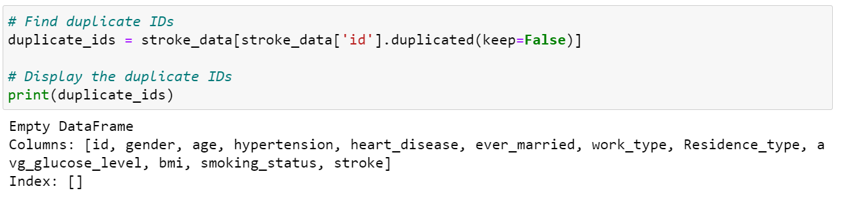
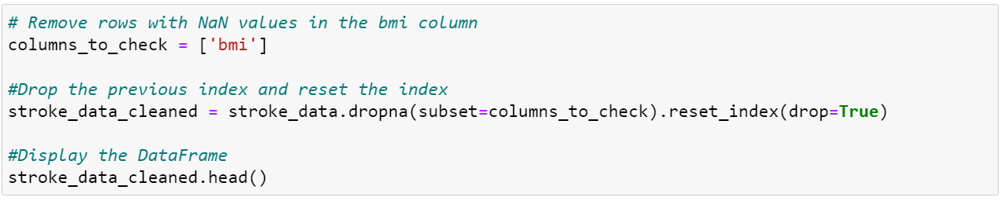
Data Preprocessing 1
Notes:
5110

Slide 10
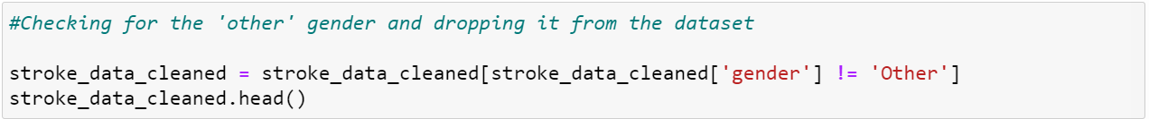
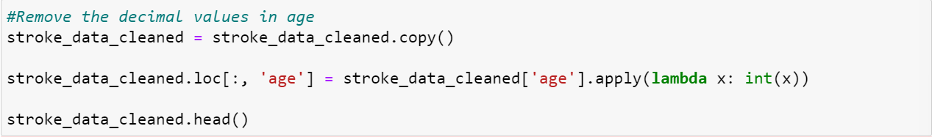
Data Preprocessing 2
Notes:
5110

Slide 11
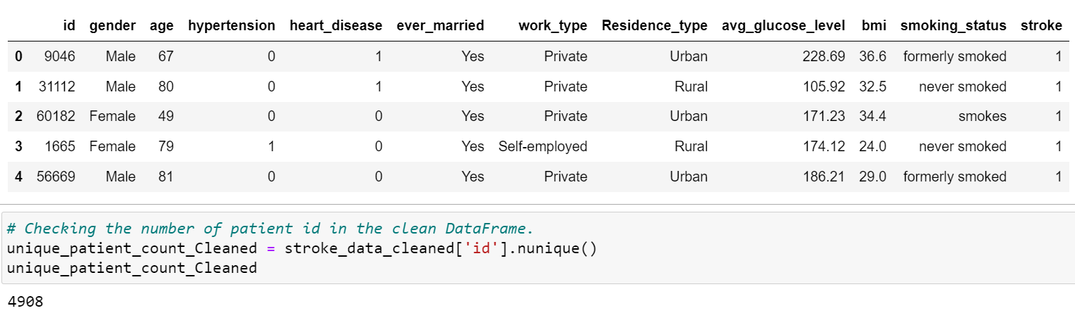
Data Preprocessing 3
Cleaned Data Frame
Notes:
5110

Slide 12
Data Visualization & Analysis

Slide 13
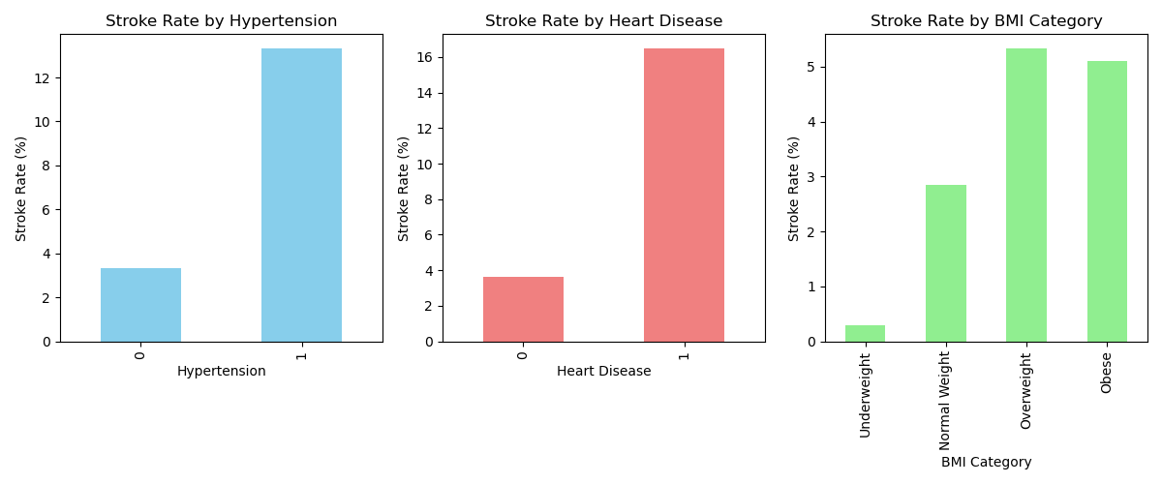
Health Conditions
1 -—-> YES
0 -—-> NO
Notes:
The figure depicts that the patients with 'hypertension & heart disease' are more likely to have stroke than the ones who do not have it.
The stroke rate for the people suffering from hypertension and heart disease is above 12% whereas those who don't suffer from same health conditions stands under 4%.
According to BMI, we observed that the obesity is directly proportional to chances of strokes and vice versa.

Slide 14
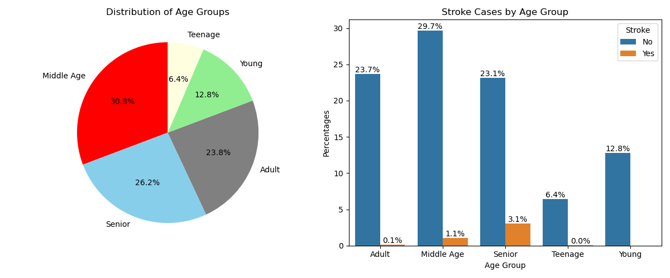
Age Group
Age Group | Years
Young | >13
Teenage | 13 – 19
Adult | 20 – 39
Middle Age | 40 – 59
Senior | 60 - 100
Notes:
About 3.1% of people who are affected by stroke are above 60 years
The pie chart shows the total patients ages are classified with different groups and bar chart splits them on the basis of stroke occurrence.
It seems like the most occurrence of stroke lies in the senior age and there seems almost no occurrence in the remaining other age groups.

Slide 15
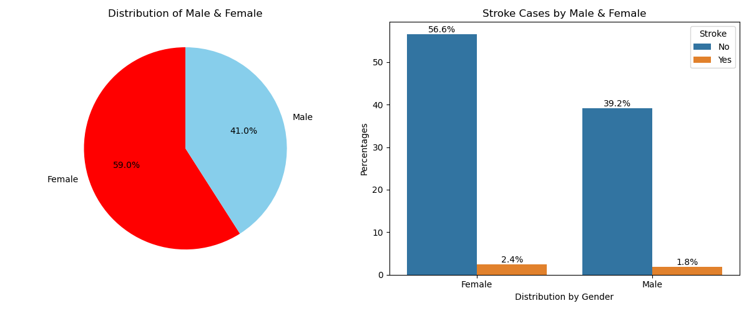
Gender
Notes:
The pie char represent the classification for male and females and shows that we have more female patients than females.
Females have slightly high occurence of stroke with 2.4% whereas the males are only 1.8%.

Slide 16
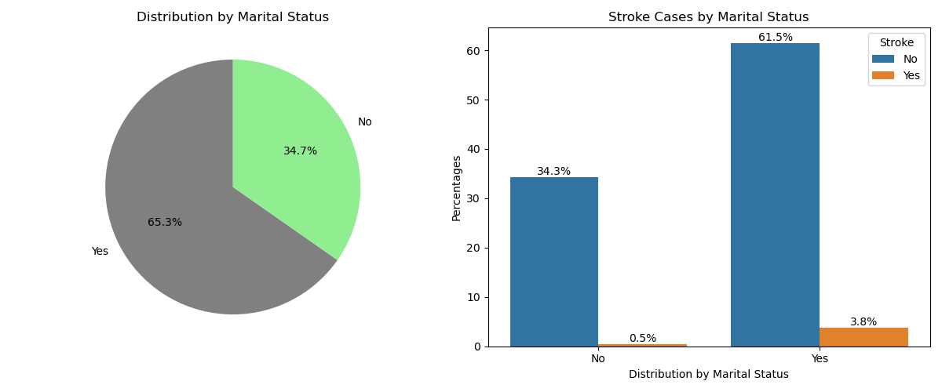
Marital Status
Notes:
The pie chart shows the overall distrubution on the basis of marital status.
Married people have more probabilty of having stroke as compare to unmarried ones.

Slide 17
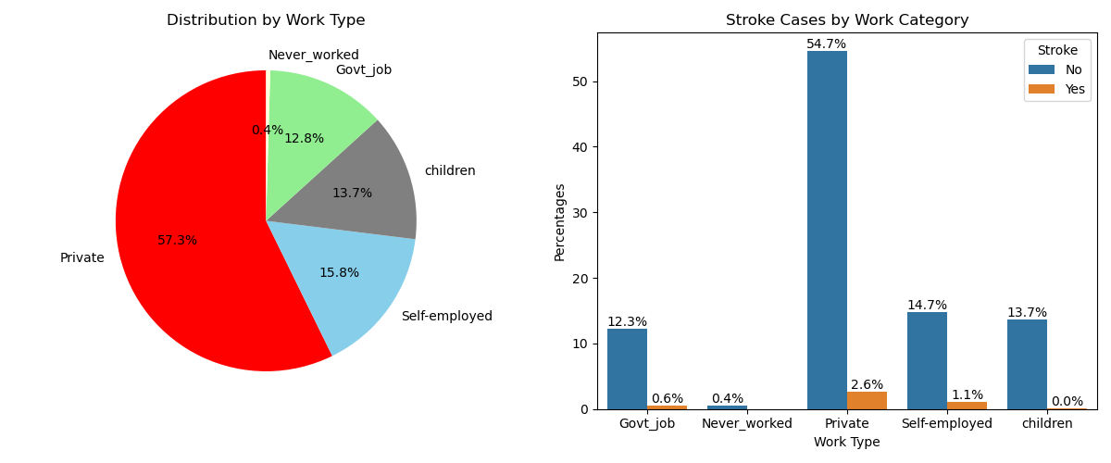
Work Type
Notes:
The pie chart repersents differentwork types such as self-employed, govt job, etc.
The bar chart depicts that the private job holders have highest stroke rate among the other categories.
People working in private sector has 2.6% of stroke and the next is Self-employed with 1.1%

Slide 18
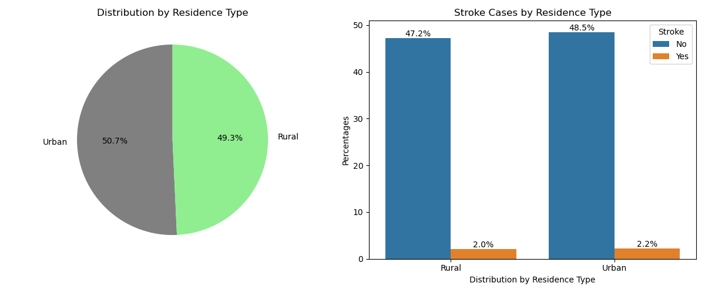
Residence Type
Notes:
Crystal clear from both visualization that there is no significant impact by the change in residence.

Slide 19
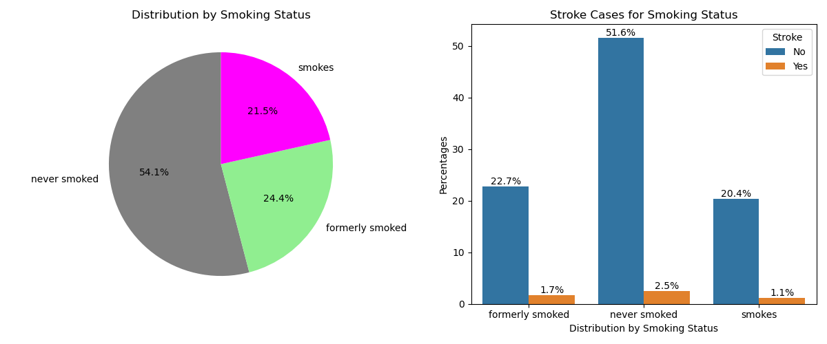
Smoking Status
Notes:
It is quite obvious from the visualizations that the smoking status is negligible risk factor for stroke.

Slide 20
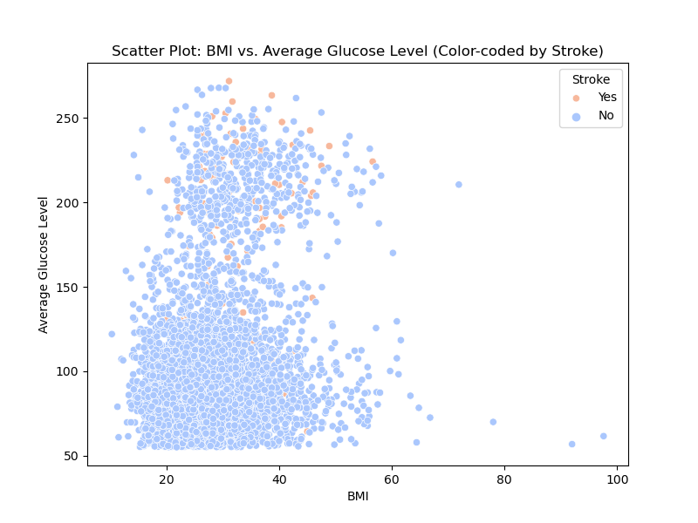
Scatter plot for BMI Vs Average Glucose Level
The scatter plot displays the data points for both the stroke patients and who don't have stroke on the basis of "BMI vs. glucose level".
Notes:
The scatter plot displays the data points for both the stroke patients and who don't have stroke on the basis of "BMI vs. glucose level".
More than 30 bmi , the individuals are obese,,.....
the more the obese person seems the more chances of stroke.

Slide 21
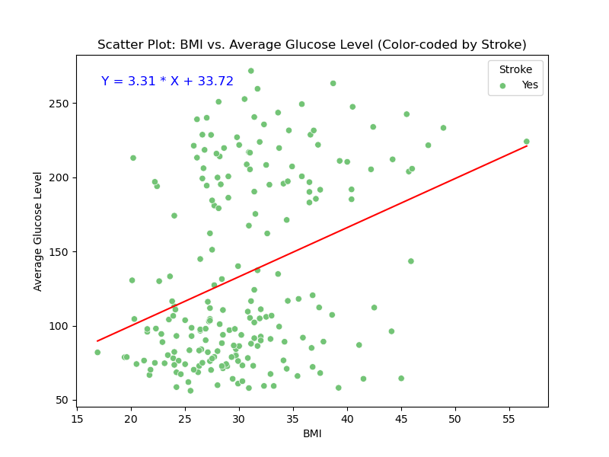
Regression line for the people affected by Stroke
This scatter plots represents the regression analysis for stroke patients.
Here the r value is 0.1 that is close to 0. So, there is a weak correlation between bmi & glucose level.
Notes:
This scatter plots represetns the regression analysis for stroke pateints.
Here the r value is 0.1 that is close to 0. So, there is a weak correlation between bmi & glucose level.

Slide 22
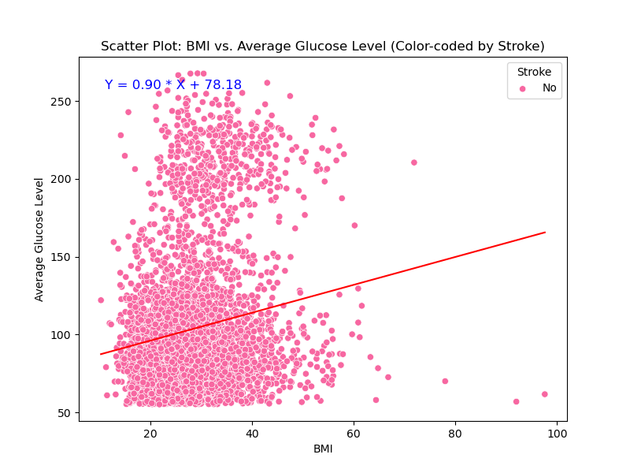
Regression line for the people not affected by Stroke
This regression analysis are about those patients who don't have the stroke.
The r value is close to 0 i.e., 0.02. It confirms that there is no significant relationship between BMI & Glucose level for chances of stroke.
Notes:
This regression analysis are about those patients who don't have the stroke.
The r value is close to 0 i.e. 0.02. It confirms that there is no significant relationship between BMI & Glucose level for chances of stroke.

Slide 23

CONCLUSION
Age is a significant risk factor for stroke, with individuals above the age of 65 having the highest stroke risk.
Hypertension and heart disease are strongly associated with an increased risk of stroke.
Gender does not appear to be a significant predictor of stroke risk in this dataset.
As females have slightly high occurrence of stroke with 2.4% whereas the males are only 1.8%.
The marital status shows a high stroke percentage in married individuals i.e. 3.8% whereas the unmarried patients have only 0.5% occurrence in stroke.
Exploring the work type, it strongly shows that the 'private' job holders are at a high risk of stroke with 2.6% than the other work categories.
Residence factor does not have any significant impact for the occurence of stroke as the number is only about 2%.
There is a poor correlation between BMI and stroke risk, particularly in obese individuals with all values of 'r' close to 0.
Stroke Rate is: 4.26%
Notes:
Understanding the interplay of age, hypertension, and heart disease is crucial for stroke prevention efforts.
While gender does not emerge as a significant predictor in this dataset, it's important to continue studying gender-based stroke risk factors in larger datasets.
Smoking cessation programs and initiatives to reduce obesity should be priorities in stroke prevention strategies.
Further research is needed to explore the reasons for the urban-rural disparity in stroke incidence.

Slide 24
Appendix

Slide 25
Data Visualizations

Slide 26
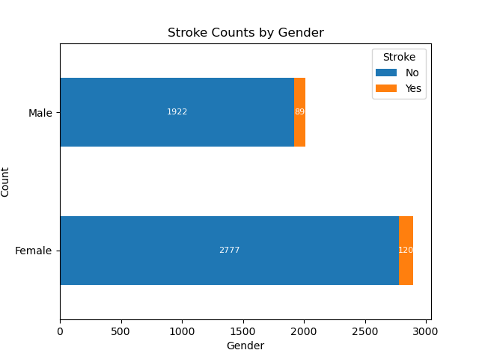
Gender
Notes:
With stroke, the stacked column chart:
Total females stroke patients: 98
Total number of males stroke patients: 120

Slide 27
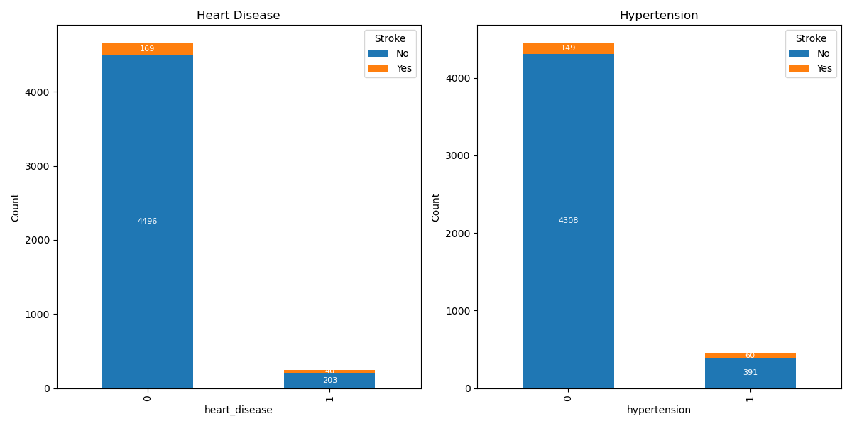
People affected by Stroke based on Heart Disease and Hypertension
People affected by heart disease and stroke is 40 and people not affected by heart disease but has stroke is 169.
People affected by hypertension and stroke is 60 and people not affected by hypertension but has stroke is 149.

Slide 28
Stroke
Every year, nearly 14,000 Canadians die from stroke. About 300,000 Canadians are living with the effects of stroke.
Additional information https://www.canada.ca/en/public-health/services/publications/diseases-conditions/stroke-canada-fact-sheet.html

Slide 29
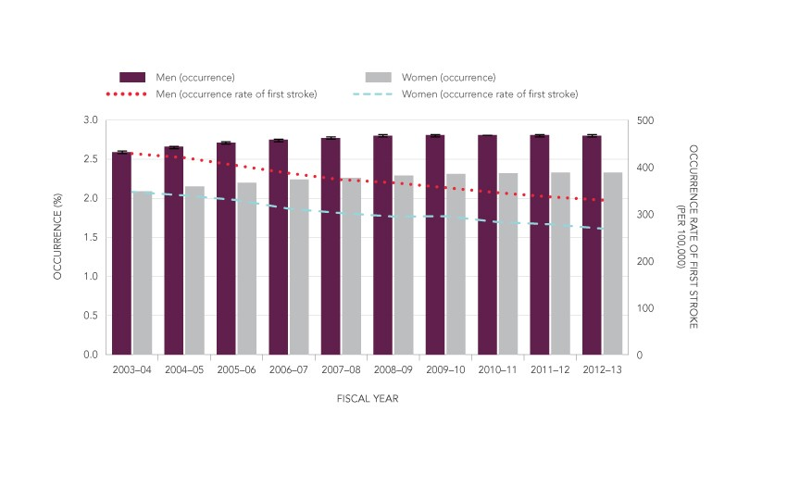
How Many Canadians Have Experienced a Stroke?
The number of adults aged 20 and older who experienced a stroke rose steadily over the decade between 2003–2004 and 2012–2013 with the addition of over 215,000 survivors.
The occurrence and rate of first stroke are consistently higher among men than women over time . However, more women than men have a stroke each year, in part because women have a longer life expectancy.

Slide 30
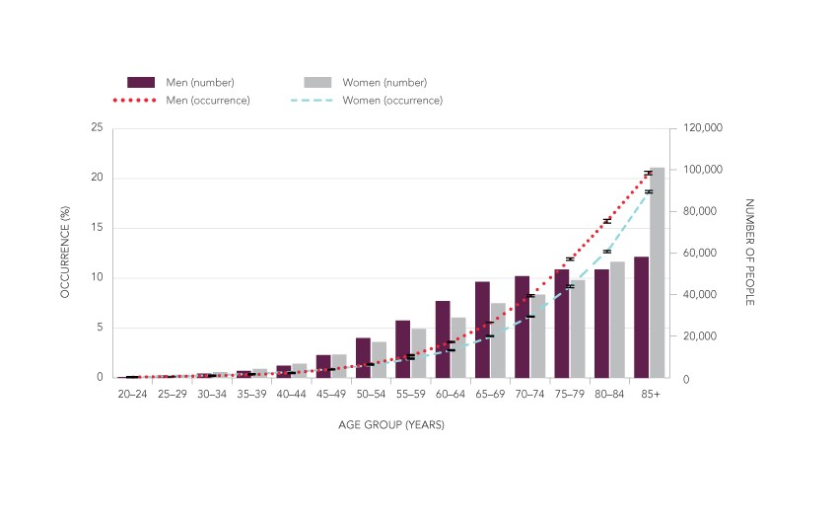
Stroke rate based on Age group
Stroke predominantly affects older people with about 10% of adults aged 65 years and older having experienced a stroke
Women and men have similar stroke occurrences in the younger age groups. However, men aged 60 years and older have consistently higher occurrence than women of the same age.
a greater number of men than women are stroke survivors between the ages of 50 and 79 years, among those ages 80 and older, the number of women who survived a stroke exceeds that of men.

Slide 31
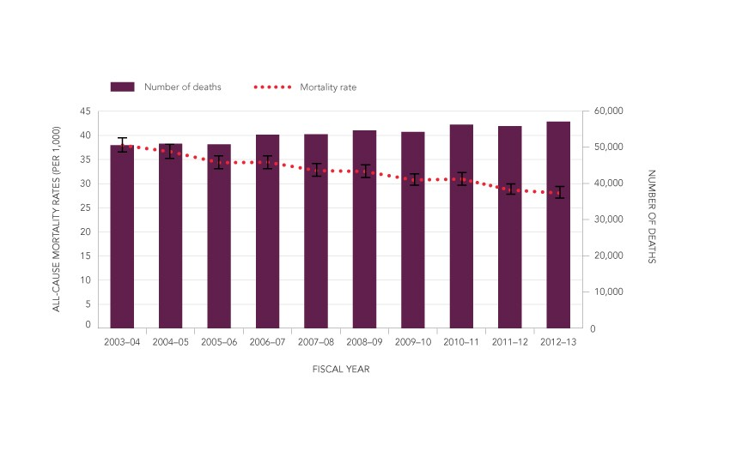
Mortality Rate
Age-standardized all-cause mortality rates among those who experienced a stroke decreased between 2003–2004 and 2012–2013, from 38.0 per 1,000 to 28.1 per 1,000.

Slide 33


